Slide 1
Predicting Bank Loan Approval Based on Risk
DSCI 550 TEAM 6
Ravish Kamath | Eddie Zhao | Jackson Crawford | Cameron Ela

Slide 2
Business Problem
We are working in a modern commercial bank as a Data Scientist where we built regression models.
We build regression models for predicting the probability that those loans would be defaulted on. However, we realize that these models do not exactly work.
TASK:
Build a more efficient default probability model that can be used in production for deciding whether a customer should receive a loan or not.

Slide 3
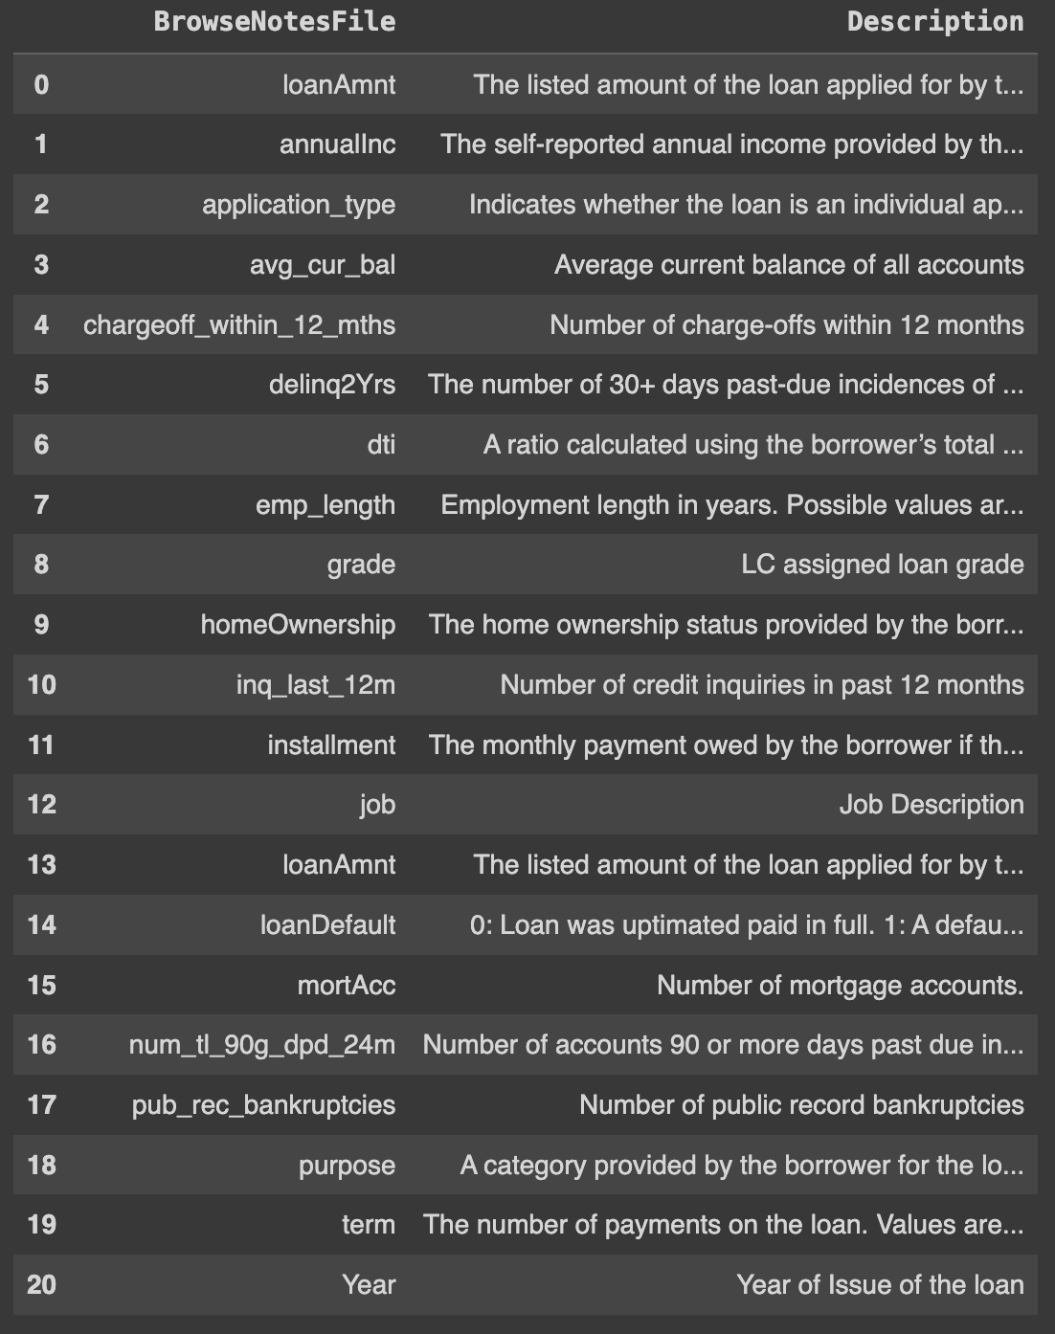
Data set and Description
ATTRIBUTES:
- Loan Default (VARIABLE OF INTEREST)
Loan Amount
Annual Application Type
Average Current Balance
Charge-offs within 12 months
Delinq 2Yrs
DTI
Employment Length
Grade (Loan)
Home Ownership
Number of Credit Inquires
Installment
Job
# of Mortgage Accounts
# of Accounts 90 or more days due
# of public record bankruptcies
Purpose
Term
Year

Slide 4
EXPLORING THE DATA

Slide 5
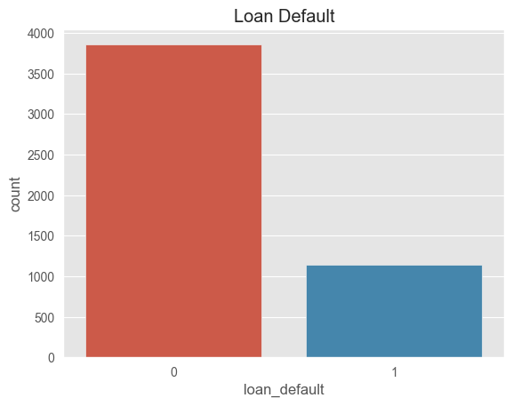
Target Variable
We can see that around 20-25 percent of all loans in the data set are defaults
Due to the biasness towards non-defaults, we need to consider resampling our dataset to create equal amount of each category.
Using F1 Score for deciding the success of a model would make sense.

Slide 6
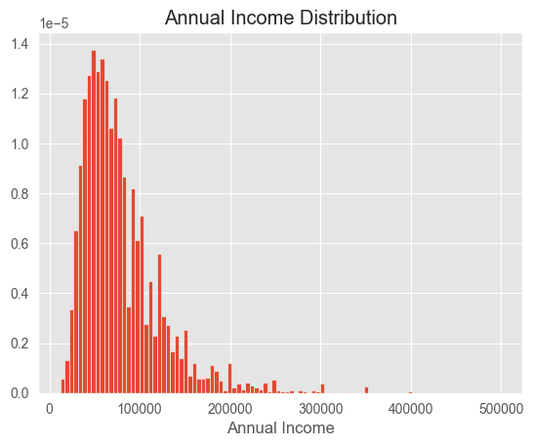
ANNUAL INCOME
We can see in the left graph that annual income is skewed right.
We can proceed to do a log transformation, to create a more normally distributed data for annual income.

Slide 7
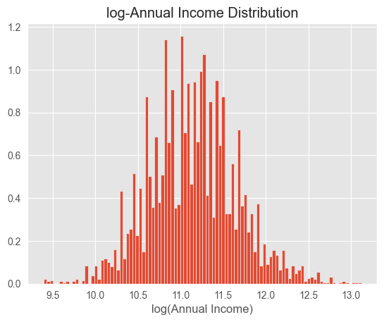

Slide 8
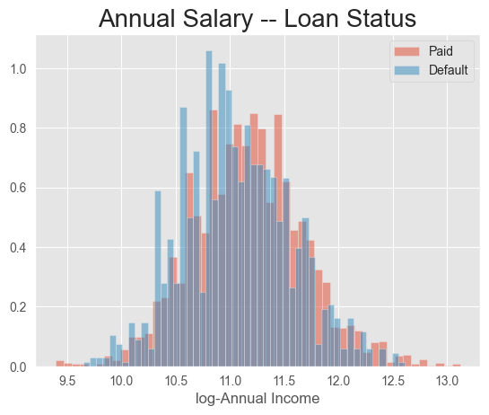
Annual Income On Default Stat
We can see that the distribution for both the groups in terms of their annual income are similarly distributed.
This can indicate that income is not likely to explain the difference in loan status.

Slide 9
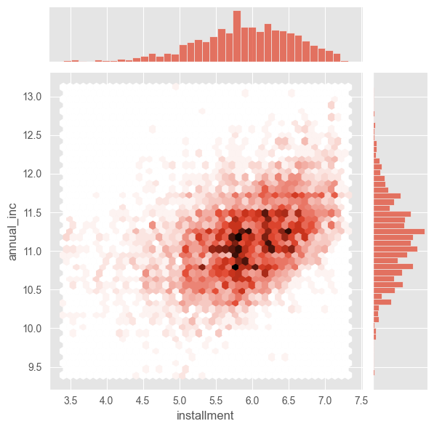
Association: Annual Income & Monthly Installments
This plot looks at the relationship between annual income and monthly installments.
We can see that there is a more linear relationship between these 2 variables, with a few outliers on the far left.

Slide 10
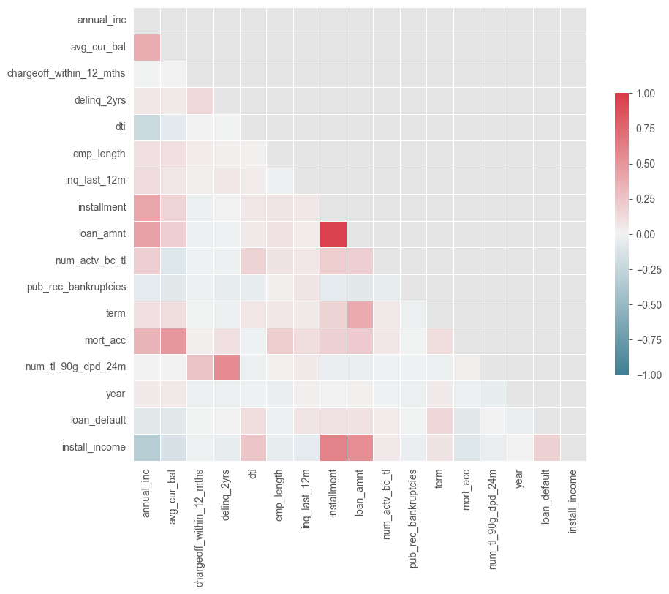
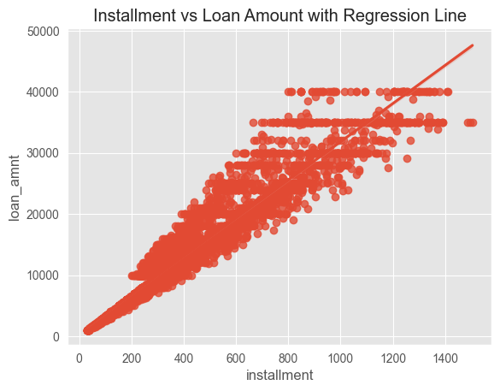
Correlation Plot
Created a correlation plot to see which variables relate towards our target variable.
We notice a high correlation between loan amount and installment. This could lead to multicollinearity problems. Best to drop or transform these variables.

Slide 11
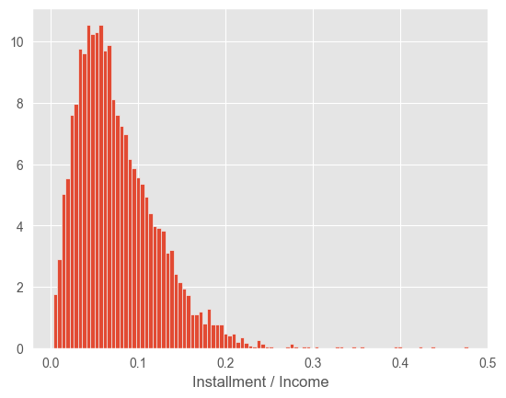
New Variable
The yearly payment owed by the borrower, as a fraction of annual income, is a standard metric used in evaluating whether a loan should be issued.
We create a new variable that calculates this using the installment variable and annual income.
Install_income = 12 * Installment/ (annual Income)

Slide 12
END OF PRESENTATION

